Slide 1
UML Introduction
The basics and diagrams

Slide 2
UML 2.0 Introduction
Unified Modeling Languange(UML)
A graphical way of describing software systems
Notes:
Language independent
Provides graphical way to illustrate relationships between classes in an object-oriented system
Provide a way to draw an abstract diagram of the class so that we can inspect features visually without having to look at the code
Lay out ideas visually and communicate with other people

Slide 3
UML Diagrams
Activity Diagrams
Class Diagrams
Sequence Diagrams
Communication Diagrams
State Machine Diagrams
Component Diagrams

Slide 4
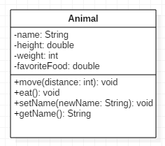
Class Diagrams
Classes
Classes diagrams
Abstraction
Encapsulation
Notes:
Class diagrams are Uml standard, in practice there are differences between
the diagrams produced by different tools. Not all tools support all uml features some tools at extra features and the final appearance of diagrams drawn by different tools varies.
Generally a class is represented with a box and the box is divided into 3 areas
The top area gives you the name and as well as any little annotations f
We are going to run down the concepts in the slides first and I’ll show you a couple of tools I’ve found online and show you how to use them.

Slide 5
Basic Method Diagram
name
type
+getAge() : int
+setAge(Age : int) : void
visibility
name
parameters
return type

Slide 6
Class Item Visibility
Public (+) : Accessible to all
Protected ( # ) : Class & Subclasses can access
Private ( - ) : Class Methods Only and Not Subclasses
Package / Default ( ~ ) : Can be called by any class within package
In LabVIEW, attributes are scoped private by default
Methods are scoped public default
Notes:
In LabVIEW there is enhanced type of class relationship called community.

Slide 7
Relationships between Classes
Drawn using arrows to connect classes together
Can represent relationships between the classes themselves
e.g. Generalization
Can represent relationships between instances of the classes
e.g. Association
Multiplicity

Slide 8
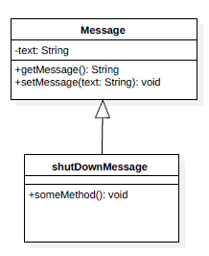
Generalization(Inheritance)
Shows “is-a” relationship between classes
Used for languages that support inheritance
Child classes is a subclass of the parent class
Notes:
This type of relationship is drawn by connecting a line from child class to the parent class with a hollow arrow at the parent class side and pointing to parent class.
We leave multiplicity on this type of relationship since generalization are between classes themselves and not between instances of classes

Slide 9
Multiplicity
Declaring an attribute represents a group of Objects
An optional: 0..1
Specific number : n
Range of numbers : m..n
Unbounded ranges : 1..*
Zero or more: *
Notes:
Each relationship in a class diagram can have multiplicity numbers assigned to one or both ends of the line connecting the classes
Multiplicity values specify how many instances of a class are involved in a relationship

Slide 10
Association
Association: Classes have a direct relationship with each other, but don’t necessarily have attributes attributed
Unidirectional association
Bidirectional association
Add examples
Notes:
The most abstract way to describe static relationship between classes is using the Association link, which simply states that there is some kind of a link or a dependency between two classes or more.
Direction of arrow indicates navigation

Slide 11
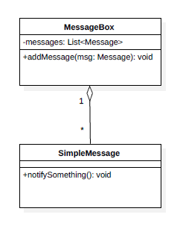
Aggregation
Weak type of “has-a” relationship between
class instances
One class contains a collection of instances
of other classes
Key idea: the instances of the other class
can exist independently of the collection
Notes:
in which an instance one class provides/has a collection of instances of other classes
It’s important to note that the Aggregation relationships are considered weak ‘has-a” relationships because the instances that are collected by the collecting class can exist independently from the collecting class.
In practice, this usually means that we create instances of various classes and then add those instances to the collection, typically with a dedicated method in the collector
MessageBox acts as a collectiomn of message instances and it provides a method to addMessage to add an instance of a message to the collection. This Message is already created elsewhere in the code before the ad message method is called.
Message do not rely on each other to exist. The existence of the MessageBox is independent of the existence of the Message
\

Slide 12
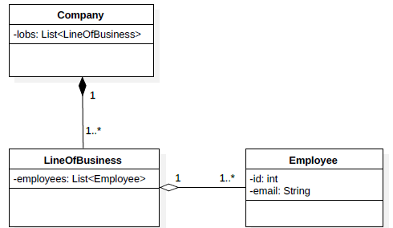
Composition
Strong type of “has a” relationship
Class contains one or more instances of another class
Key difference from aggregation: the instances cannot
exit on their own – normally created and destructed
by the containing class
Notes:
There are no methods required to manage the collection of the composed instances
In other words the lifecycle of the part class depends on that of the whole class
Graphically the composition relationship is represented by a filled diamond at the composing instance end of the relationship as shown in the example.

Slide 13
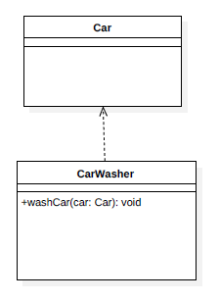
Dependency
Dependency: Objects work briefly with objects of another class
Ex. Car is passed as a parameter, and used as output
CarWasher doesn’t have an attribute of type Car, and Car is only temporarily used by CarWasher
Often ignored in class diagram

Slide 14
Class Relationship Strength
Dependency
Bidirectional
Association
Composition
Weak(Loose Coupling)
Strong (Tight Coupling)
Unidirectional
Association
Aggregation
Composition

